Slide 1
The Last Lecture
CS 5010 Program Design Paradigms
"Bootcamp"
Lesson 12.1
© Mitchell Wand, 2012-2015
This work is licensed under a Creative Commons Attribution-NonCommercial 4.0 International License.

Slide 2
Key Points for this Lesson
We summarize the key points we hope you take away from this course, regardless of what language you program in.
We send you off with some concluding words of encouragement.

Slide 3
Let’s see where we’ve been
Data Representations
Design Strategies
Basics
Combine simpler functions
Generalization
Mixed Data
Use a template
Over Constants
Recursive Data
Divide into Cases
Over Expressions
Functional Data
Call a more general function
Over Contexts
Objects & Classes
Recur on subproblem
Over Data Representations
Stateful Objects
Communicate via State
Over Method Implementations
The dark boxes indicate topics that were the major focus of one more lessons; the lighter boxes indicate topics that we mentioned in passing but didn’t cover in detail.

Slide 4
The Point
1. It’s not calculus. Getting the right answer is not enough.
2. The goal is to write beautiful programs.
3. A beautiful program is one that is readable, understandable, and modifiable by people.

Slide 5

Your programs should look like this:
source

Slide 6
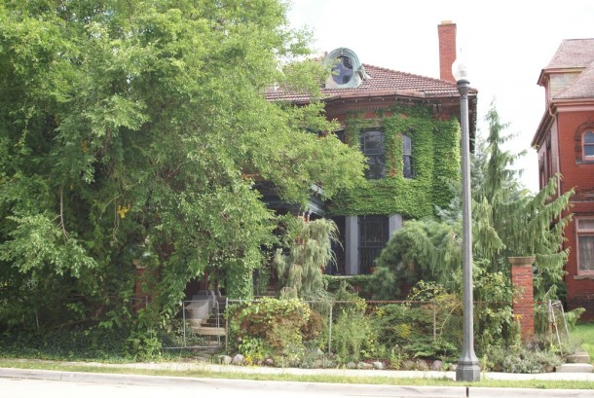
Not like this
source

Slide 7
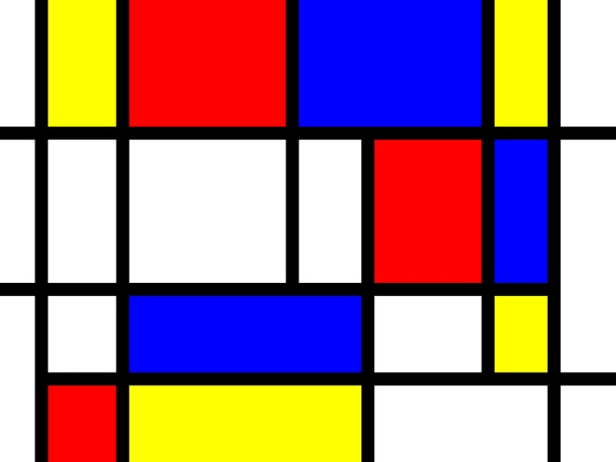
Your programs should look like this
source

Slide 8
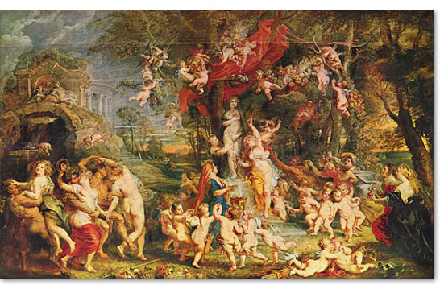
Not like this
source

Slide 9
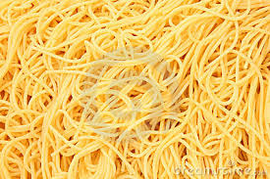
And never, ever like this
source

Slide 10
Some Slogans
1. Stick to the recipe!
2. You don't understand it until you can give an example.
3. One function, one task.
4. The Shape of the Data Determines the Shape of the Program.
5. Practice makes perfect.
Here are some slogans we had in Lesson 0.1. See if they sound familiar now.

Slide 11
Principles for writing beautiful programs
1. Always remember: Programming is a People Discipline
2. Represent Information as Data; Interpret Data as Information
3. Programs should consist of functions and methods that consume and produce values
4. Design Functions Systematically
5. Design Systems Iteratively
6. Pass values when you can, share state only when you must.
Here are the six principles from Lesson 0.1. They summarize what we hope you have learned from this course.

Slide 12
1. Programming is a People Discipline
You write programs so others can read them
Bosses, customers, maintainers, etc.
This means an older version of you, too
You work with others as you develop programs
The earlier you articulate your thinking, the earlier you can catch flaws
The earlier you catch flaws, the easier/cheaper they are to fix

Slide 13
2. Represent Information as Data; Interpret Data as Information
representation
Information
Data
interpretation
The distinction between information and data is one of the key concepts of this course. Any time we have some data, we have to give its interpretation: that is, what the data means.

Slide 14
Information Analysis and Data Design
Information is what lives in the real world
Need to decide what part of that information needs to be represented as data.
Need to decide how that information will be represented as data
Need to document how to interpret the data as information
Here is our summary slide about step 1 of the design recipe, “Information Analysis and Data Design”. You've seen this slide several times already.

Slide 15
Make your data mirror the information it represents
Understand the information in problem area
Make the structure of your data mirror the structure of the information it represents
NOT strings or arrays: think harder!
No junk: every combination of values should be meaningful
if not, document the permissible combinations with an invariant.
Always document the interpretation of your data

Slide 16
Reviewing a Data Design
Here are the questions to ask about your data design.
Reviewing a Data Design
1. Is the interpretation clear and unambiguous?
2. Can you represent all the information you need for your program?
3. Do you need all of the data in your representation?
4. Does every combination of values make sense? If not, document the meaningful combinations with a WHERE clause.
Notes:
Here is the function design recipe.

Slide 17
3. Functions and Methods Should Consume and Produce Data
Functional model makes it easy to create examples and test data
Easier to understand
Easier to test
Functions and Methods shouldn’t print
Unless that’s their real purpose, eg: tests(!)
Avoid void. Use state only when absolutely necessary.

Slide 18
Design one function/method per task
Small is good. Period.
Big is bad. Period.
If you have complicated junk in your function, you must have put it there for a reason. Turn it into a separate function so you can test it.
Use good function names.
Function names should reflect their purpose.
Function names are almost always nouns.
Function names should tell you the kind of value returned. (eg check-XXX should return a Boolean!)

Slide 19
Good function names and purpose statements help the reader
Imagine the reader is looking at some code that calls your function.
The reader should be able to make a good guess about your function produces just from its name.
If he/she needs more information, he can read your contract, purpose statement, invariants, etc.
If your purpose statement is good, the reader should never have to look at your function definition.
The only thing that matters is the value your function returns, not how it finds that value.

Slide 20
4. Design functions systematically
Go slow to arrive fast and safely
Follow the recipe!
Structure of data tells you the structure of the program
Or at least gives you good hints!
The organization of your data definitions leads you to the organization of your program.
Examples make you clarify your thinking
Be sure to cover corner cases
Tests are reusable
Be sure to cover corner cases

Slide 21
The Structure of the Program Follows the Structure of the Data
World
world-after-tick
Rectangle
Throbber
rect-after-tick
throbber-after-tick
or
x-pos
y-pos
unselected-rect-after-tick
selected-rect-after-tick
rect-x-pos-after-tick
x-vel
y-vel
rect-y-pos-after-tick
rect-x-vel-after-tick
A Portion of the Data Tree
rect-y-vel-after-tick
Maybe this won’t work out in every detail, but it gives you a plan!
A Portion of the Program Tree
(your wishtree)

Slide 22
The Function Design Recipe
The Function Design Recipe
1. Data Design
2. Contract and Purpose Statement
3. Examples and Tests
4. Design Strategy
5. Function Definition
6. Program Review
Here is the Function Design Recipe, which has been the heart of this course. We hope that you will follow it whenever you have a programming task. It can apply to non-programming tasks, too.
Notes:
Here is the function design recipe.

Slide 23
Typical Program Design Strategies
Design Strategies
1. Combine simpler functions
2. Use template for <data def> on <value>
3. Divide into cases on <condition>
4. Use HOF <mapfn> on <value>
5. Call a more general function
6. General Recursion
7. Update state
If you were tweeting out a description of how your function works, what would you say?
If you can’t summarize it in a tweet, your function is too complicated!
Notes:
Here is the function design recipe.

Slide 24
Choosing a Design Strategy
Trivial problem: trivial solution
Reduce the problem to one or more simpler problems:
Then reconstruct solution to your problem from the solutions to the simpler problems
In the end, there are only two design strategies: either you solve the problem directly or you reduce it to simpler problems and reconstruct the solution to your problem from the solutions to the simpler subproblems.

Slide 25
Choosing a Design Strategy
If there are independent/sequential pieces, then combine the simpler functions.
Is your problem a special case of another problem that might be easier to solve? If so, solve the more general problem, and then use generalization.
Otherwise, find one or more simpler instances of same problem:
Is the input a list? If so, consider using a HOF.
Is the simpler instance a substructure of the original? If so, use the template.
Otherwise, use general recursion.
e.g. number-list => number-list-from, mark-depth => mark-depth-from, 8-queens => n-queens
You've been doing this all term, so you probably know this. But it's worth writing down anyway.

Slide 26
Introducing Generalizations and Help Functions
Introduce a help function whenever you have a chunk of code that performs a discrete function.
Example: always replace
(if (> (+ (ball-x b)
BALL-SPEED
(ball-radius b))
BALL-X-MAX) ...)
by
(if (ball-would-hit-right-wall? b) ...)
Find a good name for your help function (after-tick-helper doesn’t qualify!) If you can’t think of a good name for your help function, then you are probably doing it wrong.
This is for readability. Do it even if this piece of code occurs only once.
Also, if you make it a standalone function, you can write tests for it!

Slide 27
Introducing Generalizations and Help Functions
Introduce a generalization whenever you start to duplicate code.
Any time you copy & paste, look for a pattern.
One is an exception; two is a coincidence; three is a pattern.
But be sure to write good purpose statements for your generalization.
It's OK to copy & paste for a while until you see the pattern. But be sure to replace them all with good generalizations. Your testers and maintainers will thank you.

Slide 28
Design, then abstract
Use built-in abstractions whenever possible:
map, fold, filter, for-each --- BUT:
Don't use these unless you are confident in their use.
Don’t reinvent the wheel.
Use other people’s code, libraries, etc. whenever possible (and legal).
You aren’t (or shouldn’t be) paid by the line!

Slide 29
Invariants (1)
Your function may need to rely on information that is not under its control
eg: an inventory has at most one entry for any ISBN
eg: the rectangle is unselected
eg: k = (length lst)
eg: u = (z+1)^2
Record this assumption as an invariant (WHERE clause).

Slide 30
Invariants (2)
If your contract is f: Something -> ??, then your function has to give the right answer for every possible Something.
An invariant (WHERE clause) limits the function’s responsibility.
If you have a WHERE clause, the function is only responsible for giving the right answer for inputs that satisfy the invariant.
f’s caller is responsible for making sure that the invariant is satisfied.

Slide 31
5. Design Systems Iteratively
Most real problems are too complex to model at once.
Pick important pieces of information, design data, write functions, & repeat.
Most real problems require too much functionality
Pick important functions, design, repeat.
New functionality may require new data designs.
But can reuse purpose statements, (some) tests, contracts.

Slide 32
Start from the top
The System Design Recipe
1. Write a purpose statement for your system.
2. Design data to represent the relevant information in the world.
3. Make a wishlist of main functions. Write down their contracts and purpose statements.
4. Design the individual functions. Maintain a wishlist (or wishtree) of functions you will need to write.
Start with a simple version of your system…

Slide 33
The Iterative Design Recipe
…and then add features, one at a time.
Adding a New Feature to an Existing Program
1. Perform information analysis for new feature
2. Modify data definitions as needed
3. Update existing functions to work with new data definitions
4. Write wishlist of functions for new feature
5. Design new functions following the Design Recipe
6. Repeat for the next new feature

Slide 34
6. Pass values when you can, share state only when you must.
How can you tell the difference between a traffic light and a TLState?
Ans: everybody sees the same traffic light.
If its state changes everybody sees it.
Sometimes you need state, but less often than you might think
Java, C++, etc. lead you to use state more often than you should.
State complicates everything!

Slide 35
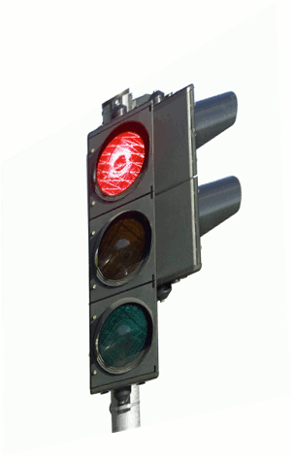


Are they seeing the traffic light or a model of the traffic light?

Slide 36
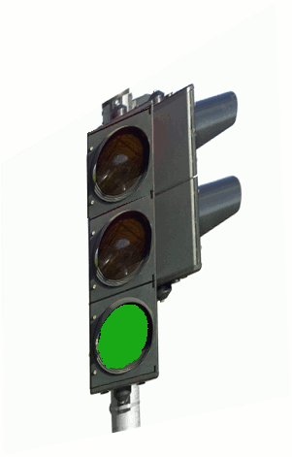
Are they seeing the traffic light or a model of the traffic light?
Now we know!
Notes:
// must capture this animation!! //

Slide 37
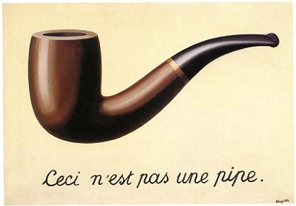
This is not a pipe
The famous painting, “This is not a pipe,” reminds us of the difference between information and data. A piece of data that is stateful represents some information, and we must always document this in our data definitions.

Slide 38
Summary: You need never be afraid of this:
You need never be afraid of a blank page.

Slide 39
You know the questions to ask
What is the relevant information from the world?
How should it be represented as data?
What is the purpose of this system/function/method?
How should I go from purpose to code?

Slide 40
And you know how to write down the answers
Data Definitions and Interpretations
Contracts and Purpose Statements
Examples and Tests
Strategies
Code

Slide 41
Go get ‘em!!
And good luck!
Stay in touch.
--Prof. Wand

